Slide 1

November 18, 2014

Slide 2
Quote of the month:
“A hundred years from now it will not matter what my bank account was, the sort of house I lived in, or the kind of car I drove... but the world may be different because I was important in the life of a child.”
Forest E. Witcraft
Used by:
Rick Bausher when Wood Badge Course Director
Rex Tillerson @ Eagle Dinner

Slide 3

COMMISSIONER
General Updates

Slide 4
#1 Priority
No Change
Notes:
3 New Commissioners in Mingo Trails!

Slide 5
#2 Priority
Recognition reports?
Prospects for DCSA?
Notes:
3 New Commissioners in Mingo Trails!

Slide 6
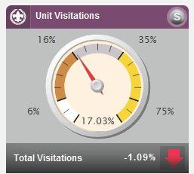
#3 Priority
Commissioner Service-
No Change

Slide 7

Journey to Excellence

Slide 8
Charter Renewal
100 % On Time!!!!
(Status report)

Slide 9

Annual Service Plan
November
  Youth Protection Visit
December
  Charter Renewal
  JTE Measurements
January
  District Evaluation
  Unit Assessment
  http://commissioner-bsa.org/service.html

Slide 10

Looking Ahead
Save-A-Scout!!!!
  Set Dates
  Recruit Team
  Plan to Succeed
10

Slide 11

Online Advancement reminder
Philmont Training Center invites
E-cigarettes, vaping – NO!

Slide 12
Career
Enhancement
What are the 3 characteristics of a good volunteer-professional relationship?
Mutual trust
Mutual respect
Mutual recognition of each other’s role and competency
When the partnership is working well, both partners are aware of their interdependence, they have complete confidence in each other, and they share the same objectives (to help units succeed in providing a quality program for youth).
#513-145 Good Volunteer-Professional Relationships

Slide 13
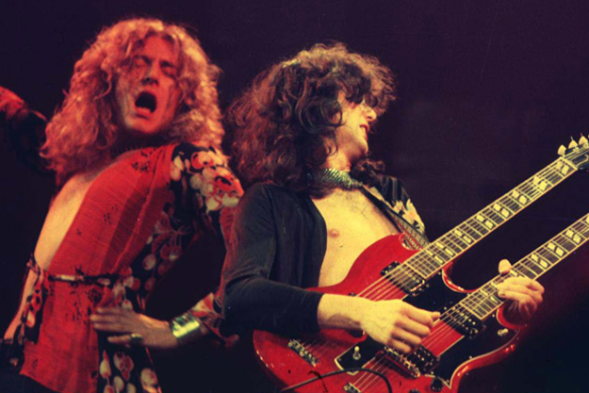
Swan Song
Website
Newsletter
E-mail blasts/reminders
Monthly PowerPoint
Council Calendar
13

Slide 14

COMMISSIONER
Training Updates
Jack Boyde
Assistant Council Commissioner – Training & Recognition

Slide 15



Commissioner Conference
June 14
Camp Guyasuta

Slide 16

COMMISSIONER
Training Updates
December 13 – Sponsored by Area 2
8:30 AM @ Flag Plaza
(Can be simulcast to Ebensburg or Cumberland)
February 14 – Area 2 (Location TBD)

Slide 17

COMMISSIONER
Training Updates
March 21, 2015

Slide 18


